Slide 1


Smoking and Periodontal Disease
RUNGTA COLLEGE OF DENTAL SCIENCES AND RESEARCH,BHILAI
PRESENTED BY:
Dr pushpendra yadav
Sr. lecturer
Dept. of Periodontology

Slide 2
SPECIFIC LEARNING OBJECTIVES
CORE AREAS | DOMAIN | CATEGORY
Introduction | Affective | Desire to know
Terminology | Cognitive | Must to know
Forms of tobacco | Cognitive | Must to know
Constituents of tobacco smoke | Cognitive | Must to know
Effects of Smoking on the Prevalence and Severity of Periodontal Diseases | Cognitive | Must to know
Effect of smoking on the etiology and pathogenesis of periodontal disease | Cognitive | Must to know
Effects of smoking on periodontal therapy Smoking cessation | Cognitive Cognitive | Must to know Must to know

Slide 3
CONTENTS
Introduction
Terminology
Forms of tobacco
Constituents of tobacco smoke
Effects of Smoking on the Prevalence and Severity of Periodontal Diseases
Gingivitis
periodontitis
Effect of smoking on the etiology and pathogenesis of periodontal disease
Microbiology
Immune-Inflammatory responses
Physiology

Slide 4
Effects of smoking on periodontal therapy
Non surgical
Surgical and implant
Maintainence
Recurrent (refractory) disease
Smoking cessation
Summary
Reference

Slide 5
INTRODUCTION
Smoking is a major risk factor for periodontitis, affecting the prevalence, extent and severity of disease.
Smoking may influence the clinical outcome of nonsurgical and surgical therapy as well as the long-term success of implant placement.

Slide 6
INTRODUCTION
Longitudinal studies have demonstrated that young individuals smoking more than 15 cigarettes per day showed the highest risk for tooth loss.
Also, smokers are more than six times as likely as non smokers to demonstrate continued attachment loss.
Over a 10-year period, bone loss has been reported to be twice as rapid in smokers as in non-smokers and proceeds more rapidly even in the presence of excellent plaque control

Slide 7
TERMINOLOGY
Current smokers
Those who smoked 100 or more cigarettes over their lifetime & smoked at the time of interview.
Former smokers
had smoked 100 or more cigarettes in their lifetime but were not currently smoking
Non smokers
had not smoked 100 or more cigarettes in their lifetime
Center for Disease Control [CDC]

Slide 8
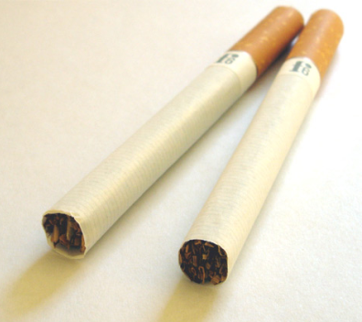

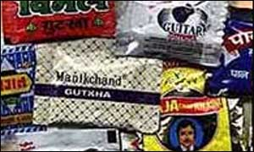
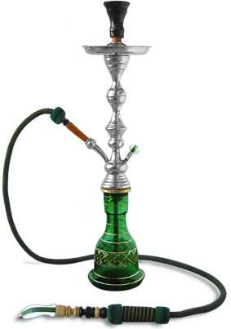

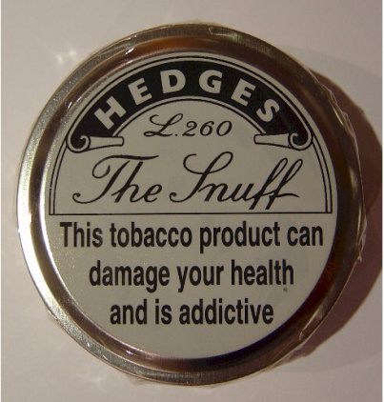


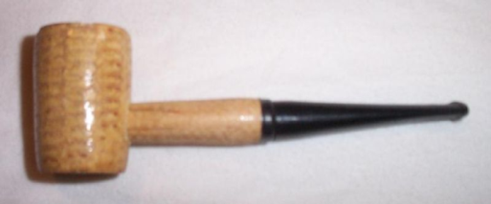
FORMS OF TOBACCO
Smoked
Smokeless

Slide 9
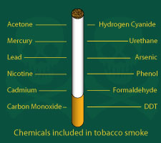
CONSTITUENTS OF TOBACCO SMOKE

Slide 10
Solid ( Particulate ) Phase
“tar” (itself made up of many toxic chemicals),
Nicotine
Benzene
Phenol
Cresol
Naphthylamine
Dimethylnitrosamine
Benzo (a)pyrene
Trace metals (eg: Nickel, arsenic, polonium 210)
Indole
Carbazole
Catechol
Gas phase
Carbon monoxide
Ammonia
Formaldehyde
Nitrosamines
Hydrazine
Vinyl chloride
Oxides of nitrogen
Hydro Cyanic acid
Acetaldehyde
Acrolein

Slide 11
TAR is inhaled with the smoke and in its condensate form, is the sticky brown substance that stains fingers and teeth yellow/brown.
NICOTINE is an alkaloid.
0.6–3.0% of dry weight of tobacco.
psychoactive drug
euphoria and
leads to withdrawal symptoms when it is absent.

Slide 12
It is quickly absorbed in the lung and reaches the brain within 10 to 19 seconds.
Pronounced effect on CVS – increase HR, CO and BP, also effects peripheral vaso- constriction .
Acts directly on blood vessels and capillaries to produce vasoconstriction.

Slide 13
COTININE is a metabolite of nicotine.
Cotinine is measured in preference to nicotine as the half-life of nicotine is short ( ≈ 1 to 2 hours) whereas that of cotinine is approximately 20 hours
Plasma and saliva cotinine concentration in smokers is approx 300 ng/ml and the urine concentration is approx 1500 ng/ml.
Non smokers usually have plasma and saliva conconcentration <2 ng/ml (unless they are passive smokers).

Slide 14
Effects of Smoking on Prevalence and Severity of Periodontal Disease
Gingivitis
↓Gingival inflammation and bleeding on probing
Periodontitis
↑Prevalence and severity of periodontal destruction
↑Pocket depth, attachment loss, and bone loss
↑Rate of periodontal destruction
↑Prevalence of severe periodontitis

Slide 15
Effects of Smoking on Prevalence and Severity of Periodontal Disease
↑Tooth loss
↑Prevalence with increased number of cigarettes smoked per day
↓Prevalence and severity with smoking cessation

Slide 16
Effects of Smoking on Etiology and Pathogenesis of Periodontal Disease
Microbiology
Immunology
Physiology

Slide 17
Effects of Smoking on Etiology and Pathogenesis of Periodontal Disease
Microbiology
No effect on rate of plaque accumulation
↑Colonization of shallow periodontal pockets by periodontal pathogens
↑Levels of periodontal pathogens in deep periodontal pockets

Slide 18
Immunology
Altered neutrophil chemotaxis, phagocytosis, and oxidative burst
↑TNF–α and PGE2 in gingival crevicular fluid (GCF)
↑Neutrophil collagenase and elastase in GCF
↑Production of PGE2 by monocytes in response to LPS

Slide 19
Physiology
↓Gingival blood vessels with ↑inflammation
↓GCF flow and bleeding on probing with ↑ inflammation
↓Subgingival temperature
↑Time needed to recover from local anesthesia

Slide 20
EFFECTS OF SMOKING ON RESPONSE TO PERIODONTAL THERAPY
Nonsurgical
↓Clinical response to scaling and root planing
↓Reduction in pocket depth
↓Gain in clinical attachment levels
↓Negative impact of smoking with ↑level of plaque control

Slide 21
Surgery and implants
↓Pocket depth reduction after surgery
↑Deterioration of furcations after surgery
↓Gain in clinical attachment levels, ↓ bone fill, ↑ recession, and ↑ membrane exposure after GTR
↓Pocket depth reduction and gain in clinical attachment levels after open flap debridement

Slide 22
Conflicting data on the impact of smoking on implant success.
Smoking cessation should be recommended before implants.
Maintenance
↑Pocket depth during maintenance therapy
↓Gain in clinical attachment levels

Slide 23
Recurrent (refractory) disease
↑Recurrent/refractory disease in smokers
↑Need for re-treatment in smokers
↑Need for antibiotics in smokers to control the negative effects of periodontal infection on surgical outcomes
↑Tooth loss in smokers after surgical therapy

Slide 24
SMOKING CESSATION
the effects of smoking on the host are reversible with smoking cessation
smoking cessation programs should be an integral component of periodontal education and therapy.
Several tobacco intervention approaches can be used in helping the patient deal with the nicotine withdrawal symptoms and psychologic factors associated with smoking cessation.

Slide 25
An appropriate approach for the dental office is the five-step program recommended by the Agency for Health Care Research and Quality.

Slide 26
“five As” approach for smoking cessation
(1) ask (identify patient’s tobacco use status),
(2) advise (on associations between oral disease and smoking and the benefits of cessation),
(3) assess (patient’s interest and readiness to participate in tobacco cessation programs),
(4) assist (use appropriate techniques to assist patient in tobacco cessation), and
(5) arrange (follow-up contacts with the patient)

Slide 27
In addition, pharmacotherapeutic treatments such as nicotine replacement therapy and sustained bupropion administration have proved effective.

Slide 28
summary
Smokers may present with periodontal disease at an early age, may be difficult to treat with conventional therapy, and may continue to have progressive or recurrent periodontitis leading to tooth loss.

Slide 29
Reference
Newman MG, Takei HH, Klokkevold PR, Carranza FA. Carranza’s clinical periodontology, 10th ed. Saunders Elsevier; 2007.
Lindhe J, Lang NP and Karring T. Clinical Periodontology and Implant Dentistry. 6th ed. Oxford (UK): Blackwell Publishing Ltd.; 2015.
Newman MG, Takei HH, Klokkevold PR, Carranza FA. Carranza’s clinical periodontology, 13th ed. Saunders Elsevier; 2018.

Slide 30
THANK YOU

